Slide 1
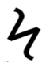
Combined maintenance and routing optimization approach for large-scale problems
John Fontecha
Daniel Duque
Raha Akhavan-Tabatabaei
Juan Pablo Rodríguez
Andrés L. Medaglia
Departamento de Ingeniería Industrial
Centro para la Optimización y Probabilidad Aplicada
Universidad de los Andes (Colombia)
Notes:
Today, I’m going to talk about a combined maintenance and routing problem and its application in Large scale problems. This is a joint work with proffesor Raha Akhavan, Juan-Pablo Rodriguez, Andrés Medaglia, and Daniel Duque. [Click]

Slide 2
Outline
Maintenance model
Simulation model
Models comparison (CMR in case study)
Maintenance models comparison
Perspectives
VRPTW (López-Santana et al)
Notes:
So, let me start with a brief motivation. [Click]

Slide 3
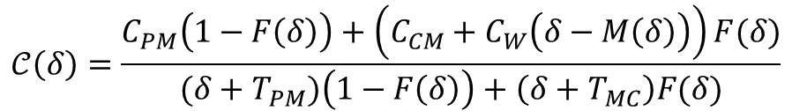
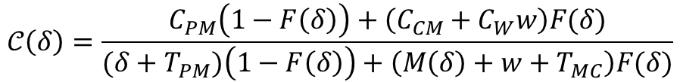
Maintenance model
$$𝒞\left(δ\right)=\frac{C_{PM}\left(1−F\left(δ\right)\right)+\left(C_{CM}+C_{W}w\right)F(δ)}{(δ+T_{PM})\left(1−F\left(δ\right)\right)+\left(M\left(δ\right)+w+T_{MC}\right)F(δ)}$$
López-Santana et al. (2016)
$$𝒞\left(δ\right)=\frac{C_{PM}\left(1−F\left(δ\right)\right)+\left(C_{CM}+C_{W}\left(δ−M\left(δ\right)\right)\right)F(δ)}{(δ+T_{PM})\left(1−F\left(δ\right)\right)+\left(δ+T_{MC}\right)F(δ)}$$
Fontecha et al. (2016)
Notes:
[click]

Slide 4
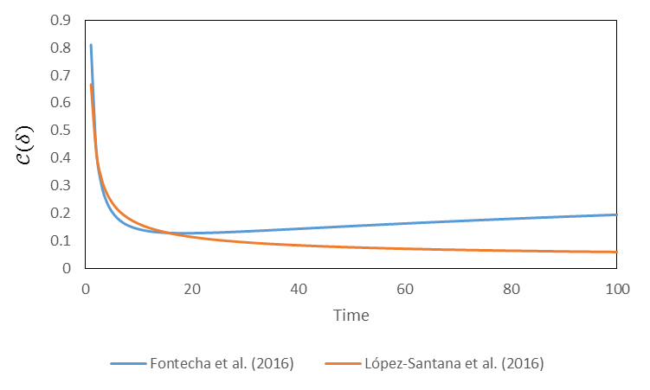
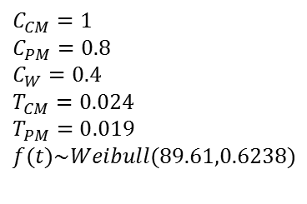
Maintenance model López-Santana et al. (2016) vs. Fontecha et al. (2016)
$C_{CM}=1$
$C_{PM}=0.8$
$C_{W}=0.4$
$T_{CM}=0.024$
$T_{PM}=0.019$
$$f(t)\sim Weibull(89.61,0.6238)$$
Notes:
[click]

Slide 5
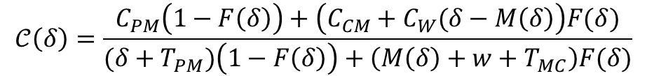
Maintenance model
$$𝒞\left(δ\right)=\frac{C_{PM}\left(1−F\left(δ\right)\right)+\left(C_{CM}+C_{W}(δ−M\left(δ\right)\right)F(δ)}{(δ+T_{PM})\left(1−F\left(δ\right)\right)+\left(M\left(δ\right)+w+T_{MC}\right)F(δ)}$$
López-Santana et al. (2016)
modification
Notes:
[click]

Slide 6
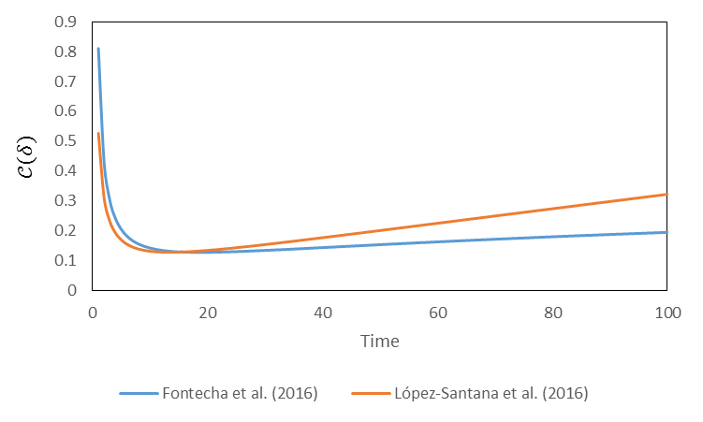
Maintenance model López-Santana et al. (2016) modification
$C_{CM}=1$
$C_{PM}=0.8$
$C_{W}=0.4$
$T_{CM}=0.024$
$T_{PM}=0.019$
$$f(t)\sim Weibull(89.61,0.6238)$$
Notes:
[click]

Slide 7
Simulation model
We have some differences in Maintenance Model
We use a different methodology to define and to solve the Routing Model
HOW WE CAN COMPARE THE SOLUTIONS?
Notes:
[click]

Slide 8
Simulation model
Motivation
Objective functions are not comparable.
The time in which each maintenance operation is scheduled is computed.
The type of maintenance operation (corrective or preventive) is unknown.
Solution
Simulate the time to next the failure (event) for each site and compare it with the scheduled time for the site.
Notes:
[click]

Slide 9



Simulation model
For each site $i∈𝒱_{s}$:
If a failure occurs after the scheduled time, a preventive maintenance operation is going to be performed.
$$𝒞_{i}=C_{PM}^{i}$$
If a failure occurs before the scheduled time, a corrective maintenance operation is going to be performed.
$$𝒞_{i}=C_{CM}^{i}+C_{W}^{i}w_{i}$$
$$w_{i}=maintenance {time}_{i} −failure {time}_{i}$$
Notes:
[click]

Slide 10
Simulation model Simulation logic
Maintenance Model
Routing
Model
Input
Output
Notes:
[click]

Slide 11
Simulation model Simulation logic
Maintenance Model
Routing
Model
Input
Output
Simulation-Based Validation Model
Performance measure
Notes:
[click]

Slide 12
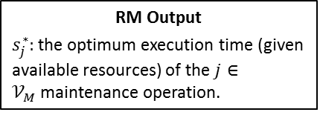
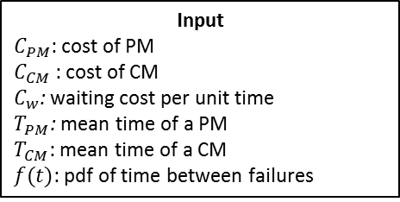
Simulation model Simulation logic
Input
$C_{PM}$: cost of PM
$C_{CM}$ : cost of CM
$C_{w}$: waiting cost per unit time
$T_{PM}$: mean time of a PM
$T_{CM}$: mean time of a CM
$f(t)$: pdf of time between failures
RM Output
$s_{j}^{∗}:$ the optimum execution time (given available resources) of the $j∈𝒱_{M}$maintenance operation.
Simulation-Based Validation Model
Output
Expected cost of the maintenance scheduling.
Induce failures
Notes:
[click]

Slide 13


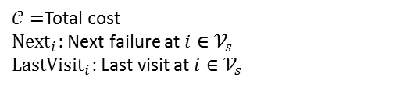
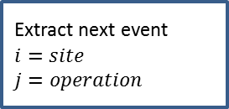

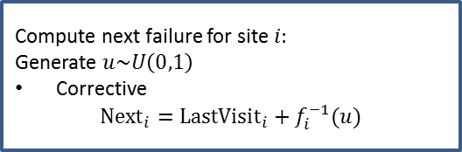

Simulation model Simulation logic
Sort maintenance operations by time and compute first failure for all sites
$𝒞=$Total cost
${Next}_{i}$: Next failure at $i{∈𝒱}_{s}$
${LastVisit}_{i}$: Last visit at $i{∈𝒱}_{s}$
Extract next event
$i=site$
$j=operation$
Compute next failure for site $i:$
Generate $u\sim U\left(0,1\right)$
Corrective
$${Next}_{i}=LastVisit_{i}+f_{i}^{−1}(u)$$
Update event calendar
Site info
Event=failure?
True
$${LastVisit}_{i}=s_{j}+T_{CM}$$
$$𝒞+=C_{CM}^{i}+C_{W}^{i}w_{i}$$
False
$${LastVisit}_{i}=s_{j}+T_{PM}$$
$$𝒞+=C_{PM}^{i}$$
Notes:
[click]

Slide 14
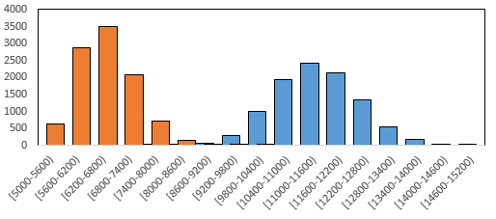
Models comparison (CMR in case study) Illustrative case study in the oil and gas industry. $𝒯=224$
López-Santana et al. (2016) vs. Fontecha et al.(2016)
10,000 replicates
López-Santana et al. (2016)
Fontecha et al.(2016)
Frequency
Cost
Notes:
[click]

Slide 15
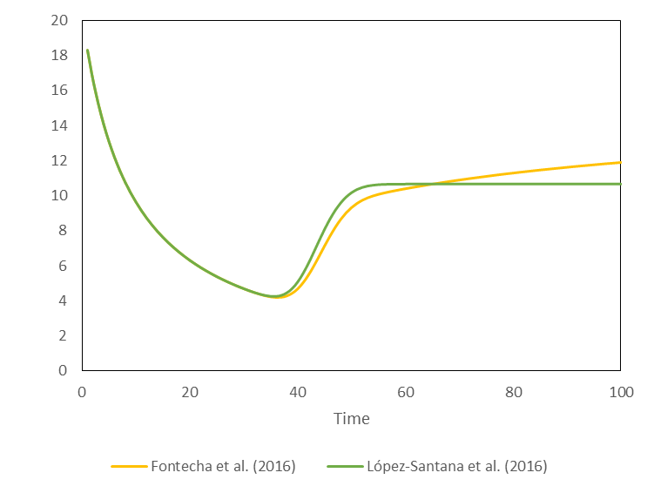
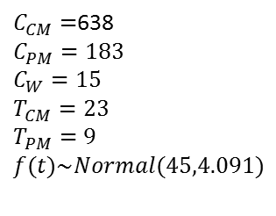
Maintenance models comparison López-Santana et al. (2016) vs. Fontecha et al. (2016)
$C_{CM}=$638
$C_{PM}=183$
$C_{W}=15$
$T_{CM}=23$
$T_{PM}=9$
$$f(t)\sim Normal(45,4.091)$$
Notes:
[click]

Slide 16
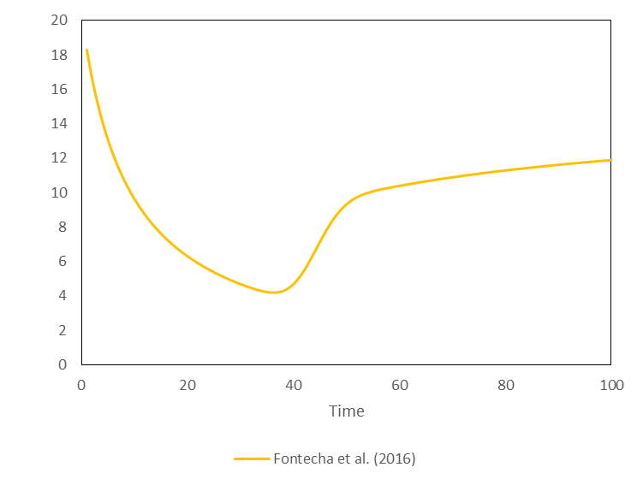
Maintenance models comparison Fontecha et al. (2016)
$C_{CM}=$638
$C_{PM}=183$
$C_{W}=15$
$T_{CM}=23$
$T_{PM}=9$
$$f(t)\sim Normal(45,4.091)$$
Notes:
[click]

Slide 17
Maintenance models comparison Fontecha et al. (2016)
$C_{CM}=$638
$C_{PM}=183$
$C_{W}=15$
$T_{CM}=23$
$T_{PM}=9$
$$f(t)\sim Normal(45,4.091)$$
Notes:
[click]

Slide 18
Maintenance models comparison Fontecha et al. (2016)
We can’t assume a convex function
$C_{CM}=$638
$C_{PM}=183$
$C_{W}=15$
$T_{CM}=23$
$T_{PM}=9$
$$f(t)\sim Normal(45,4.091)$$
Notes:
[click]

Slide 19
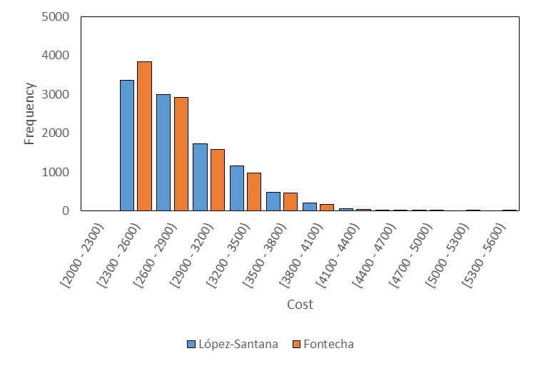
Maintenance models comparison López-Santana et al. (2016) vs. Fontecha et al. (2016). $𝒯=112$
Notes:
[click]

Slide 20
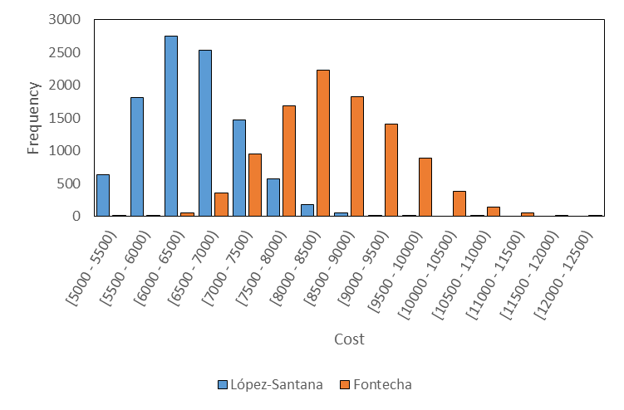
Maintenance models comparison López-Santana et al. (2016) vs. Fontecha et al. (2016). $𝒯=224$
Notes:
[click]

Slide 21
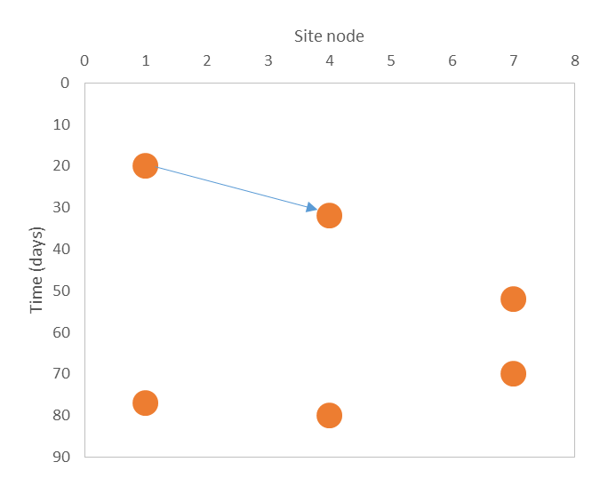
Perspectives Space-time distance
Split methodology – reimplementation.
Notes:
[click]

Slide 22
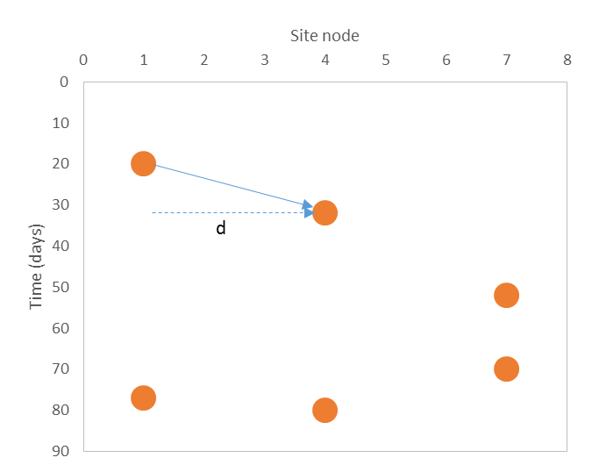
Perspectives Space-time distance
Split methodology – reimplementation.
Notes:
[click]

Slide 23
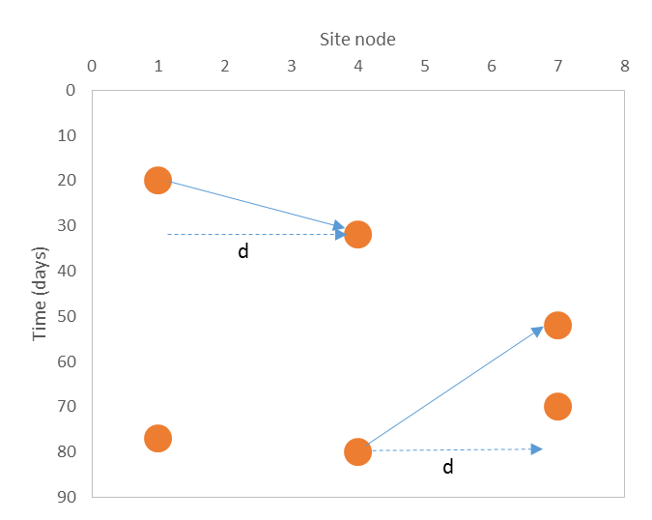
Perspectives Space-time distance
Split methodology – reimplementation.
Notes:
[click]

Slide 24
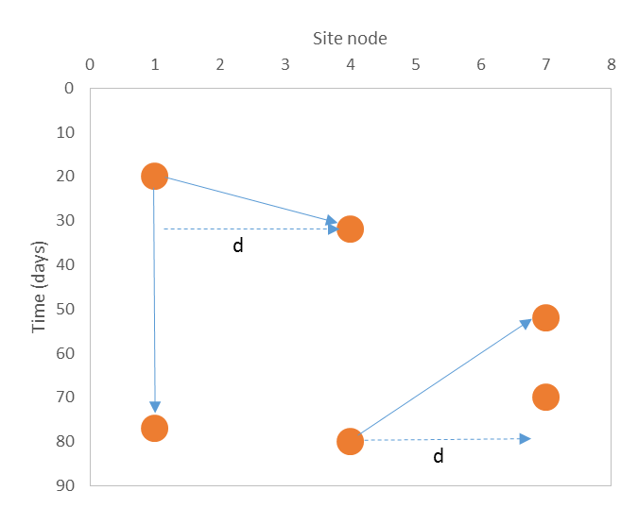
Perspectives Space-time distance
Split methodology – reimplementation.
Notes:
[click]

Slide 25
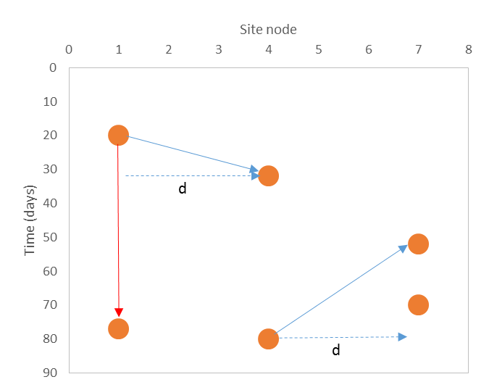
Perspectives Space-time distance
Split methodology – reimplementation.
Notes:
[click]

Slide 26

Perspectives Space-time distance
Split methodology – reimplementation.
$$d=vt$$
Notes:
[click]

Slide 27
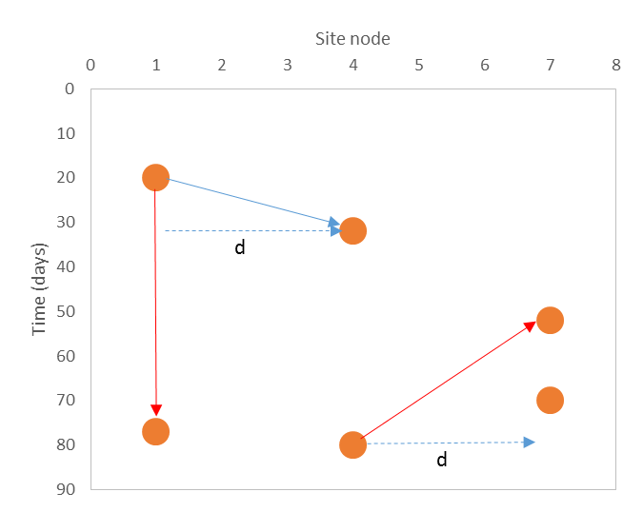
Perspectives Space-time distance
Split methodology – reimplementation.
$$d=vt$$
Back in time, distance is penalized.
Notes:
[click]

Slide 28
Perspectives Space-time distance
Split methodology – reimplementation.
$$distance=spatial distance+time distance+back in time penalization$$
Notes:
[click]

Slide 29
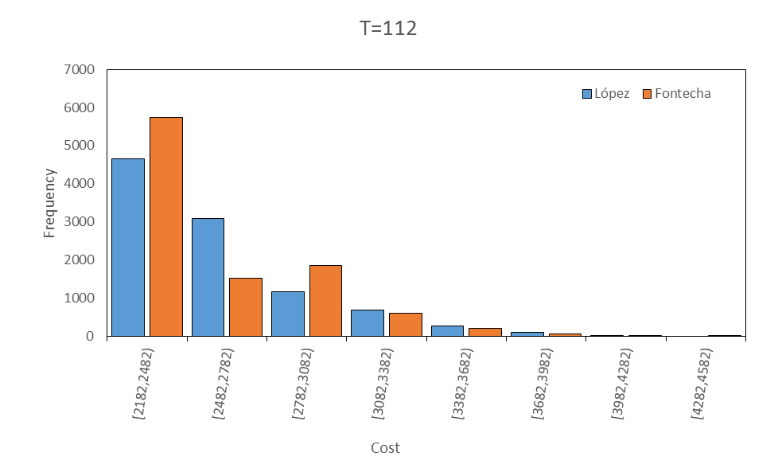
Perspectives Space-time distance - Results
Split methodology – reimplementation.
Notes:
[click]

Slide 30
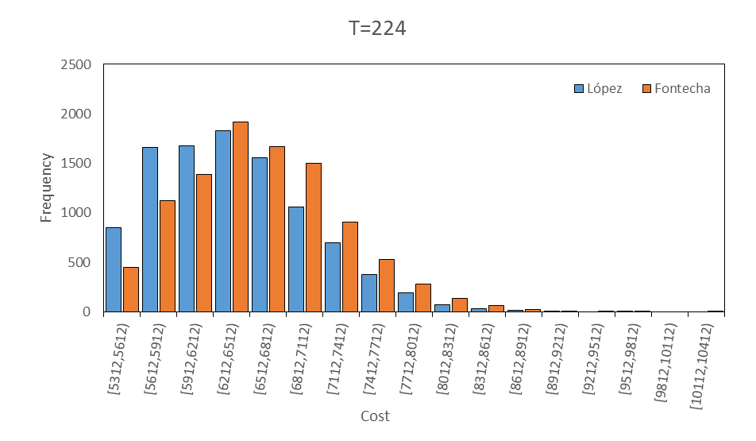
Perspectives Space-time distance - Results
Split methodology – reimplementation.
Notes:
[click]

Slide 31
Perspectives Space-time distance - Results
Split methodology – reimplementation.
Notes:
[click]

Slide 32
Perspectives Space-time distance - Results
Split methodology – reimplementation.
Instance from sewer blockages
65 Maintenance operations scheduled to be attended.
Computational time: 791 s
Notes:
[click]

Slide 33
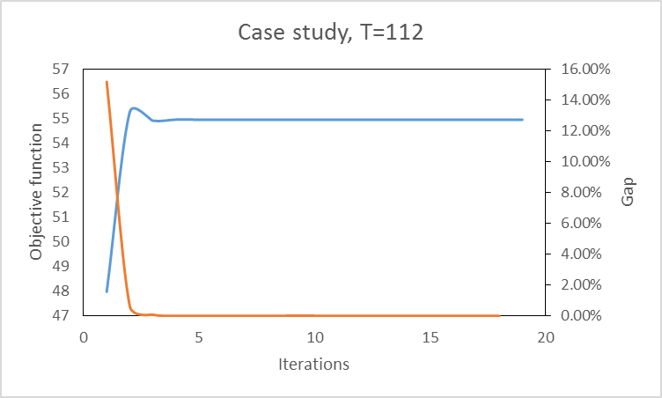
VRPTW (López-Santana et al)
Notes:
[click]

Slide 34
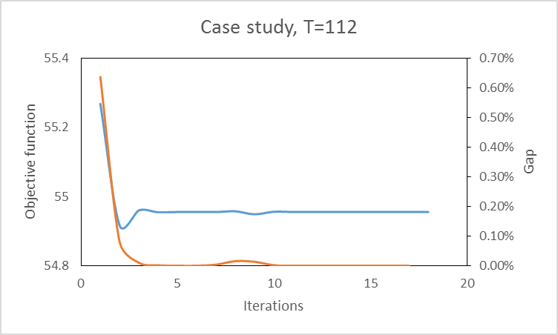
VRPTW (López-Santana et al)
Notes:
[click]

Slide 35
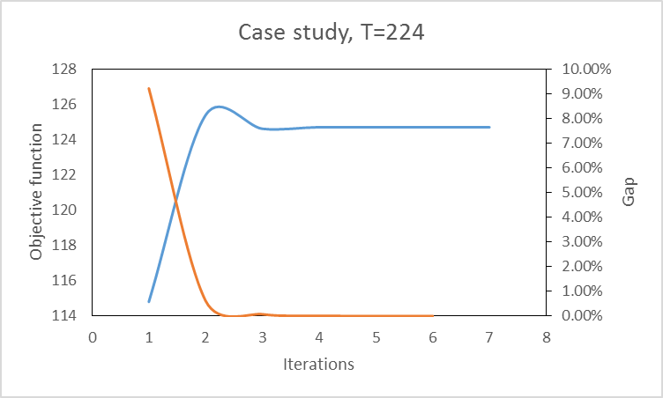
VRPTW (López-Santana et al)
Notes:
[click]

Slide 36
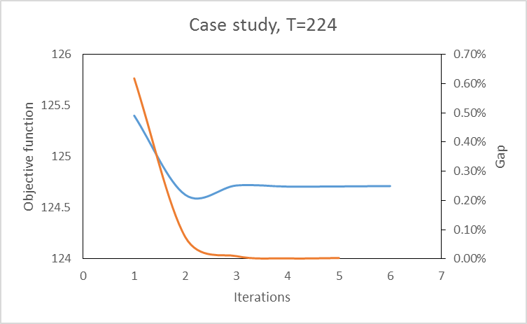
VRPTW (López-Santana et al)
Notes:
[click]

Slide 37
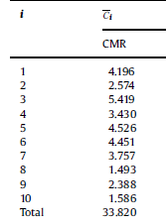
VRPTW (López-Santana et al) T=112
López-Santana et al. (2016) - Fontecha
reimplementation
López-Santana et al. (2016)
Fontecha et al. (2016)
Not reported
1529.8s
2.736s
Notes:
[click]

Slide 38
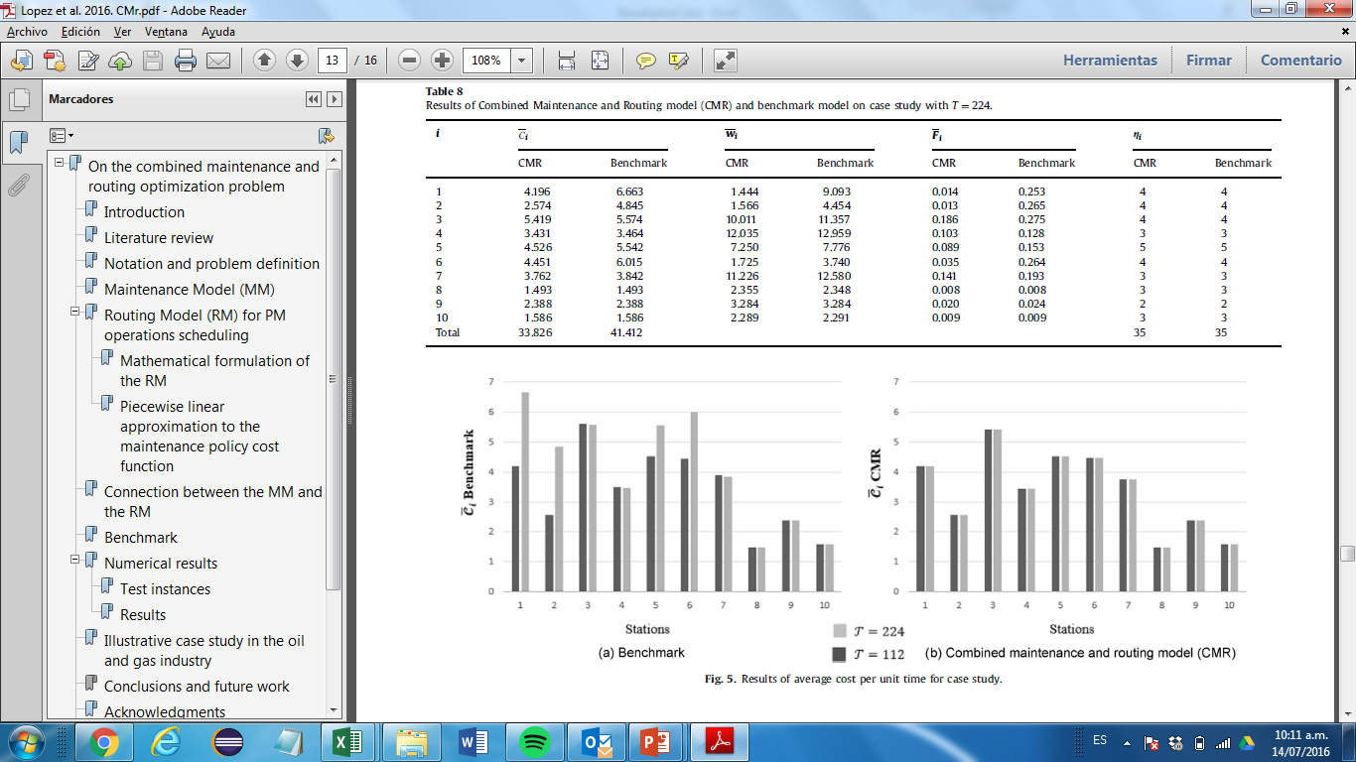
VRPTW (López-Santana et al) T=224
López-Santana et al. (2016) - Fontecha
reimplementation
López-Santana et al. (2016)
Fontecha et al. (2016)
Not reported
973.2s
4.547 s
Notes:
[click]

Slide 39
Increasing the pool size of routes
Notes:
[click]

Slide 40
Case study
Notes:
[click]

Slide 41
Case study
Notes:
[click]

Slide 42
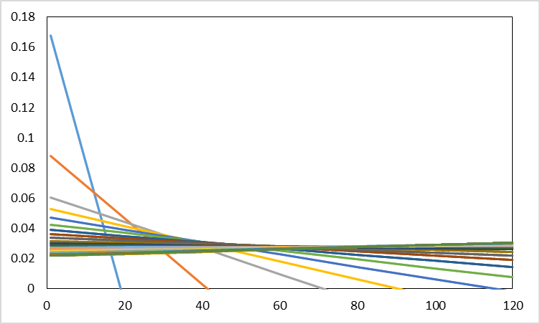
Case study
Notes:
[click]

Slide 43
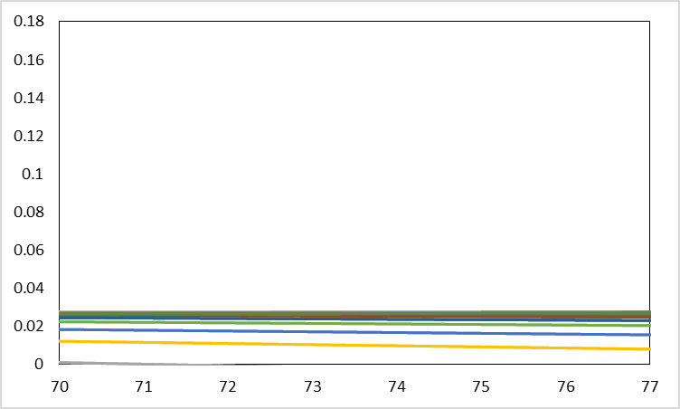
Case study
Notes:
[click]

Slide 44
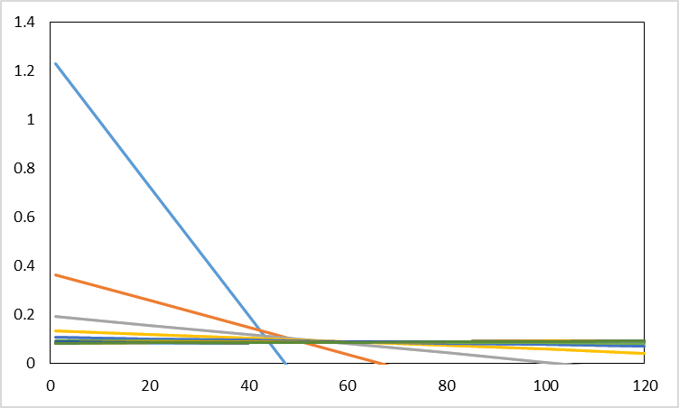
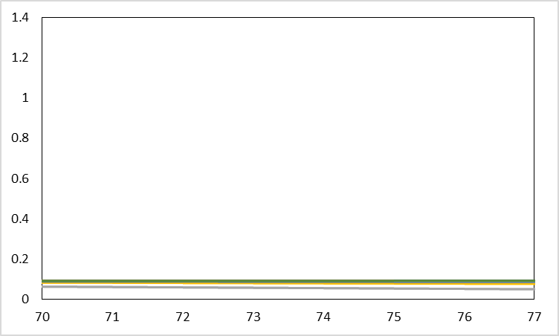
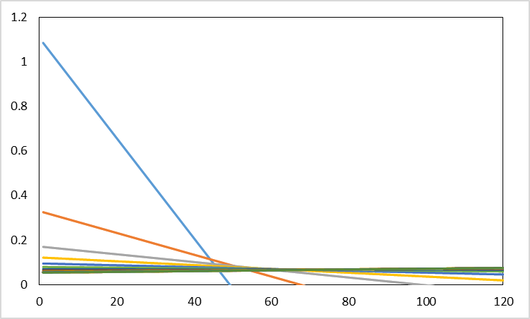
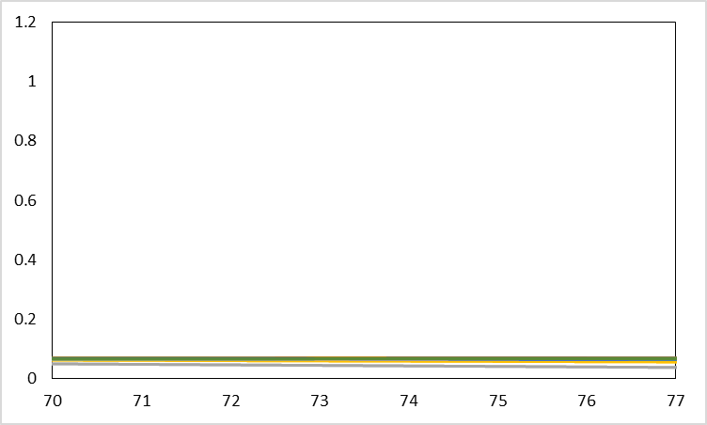
Case study
Notes:
[click]

Slide 45
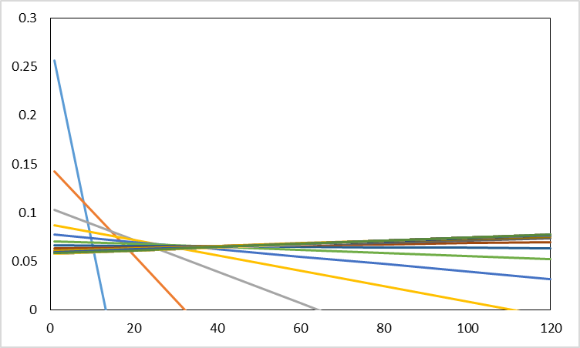
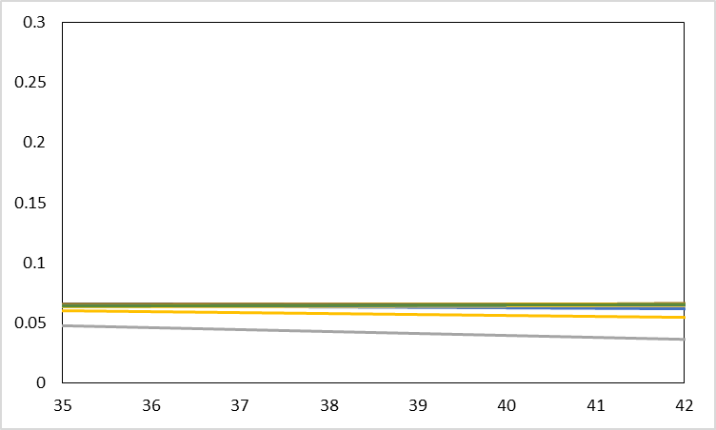
Case study
Notes:
[click]

